Slide 1
Imaging for Diagnosis of Adenomyosis
T Poordast
OB&GYN fellowship of laparascopy
Associated professor, Shiraz Univercity of Medical Sciences

Slide 5
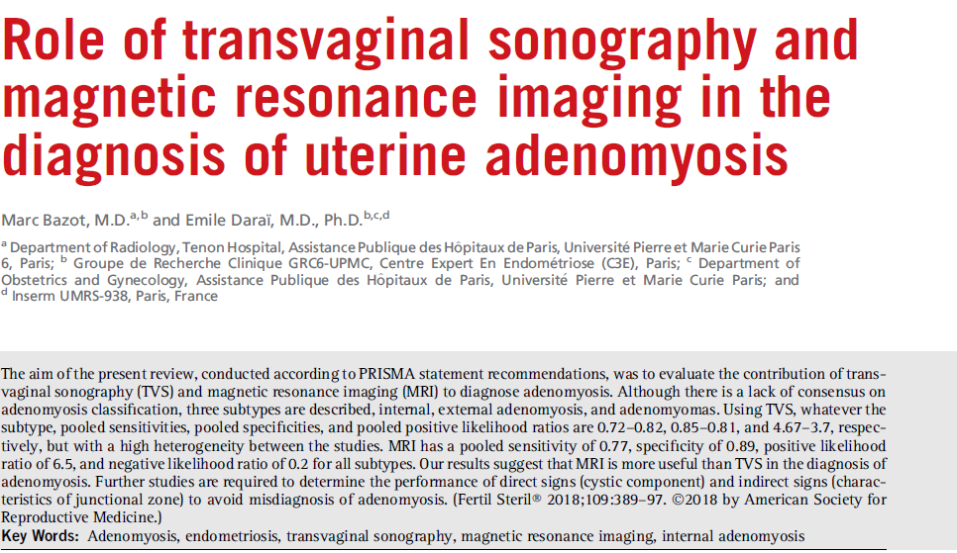

Slide 9
Preferred imaging
TVUS as the first-line diagnostic imaging method
MRI as second if TVUS is inconclusive(when conservative surgery was selected )

Slide 10
Radiographic features
Imaging features are variable and in many instances very subtle. Three (some say four) forms can be distinguished:
diffuse adenomyosis: most common
focal adenomyosis :Focal adenomyosis is identified when more than 25%of the lesion is surrounded by normal myometrium
Adenomyoma : focal lesion is completely surrounded by hypertrophic myometrium,’
cystic adenomyosis and adenomyotic cyst:A rare variant

Slide 16
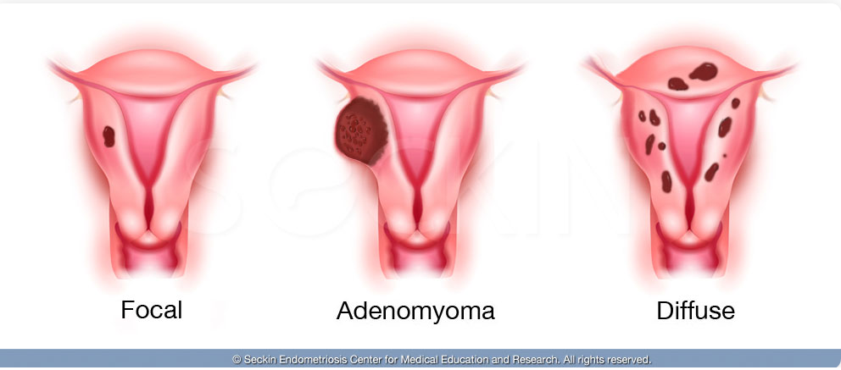

Slide 17
Ultrasound
ultrasound is usually the first and often the only imaging modality employed to investigate menorrhagia and dysmenorrhea
The spectrum of findings includes:

Slide 18
Uterine enlargement
Globular uterine enlargement that is generally up to 12 cm in uterine length
with regular external contour
not explained by the presence of leiomyomata is a characteristic finding

Slide 19
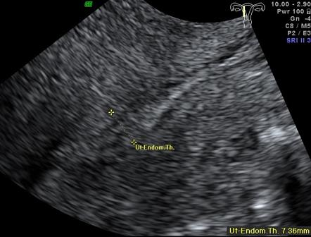
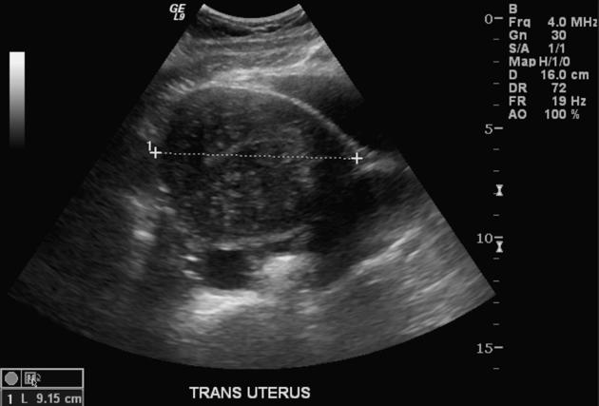

Slide 20
Uterine wall thickening
The uterine wall thickening can show anteroposterior asymmetry, especially when the disease is focal .
typically of the posterior wall
Diffuse asymmetric or symmetric widening of the myometrial wall(s) is secondary to myometrial hypertrophy and mainly related to deep diffuse internal adenomyosis

Slide 21
Asymmetrical myometrial thickening. 2D longitudinal view of a uterus with asymmetrical distances from the endometrium to the anterior and posterior serosal surfaces (arrows).

Slide 22
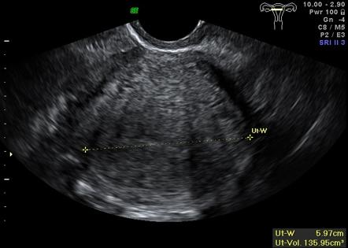
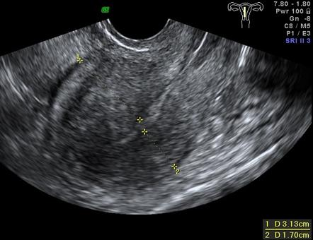

Slide 23
Question mark form of uterus
form of uterus’, was observed.
The sign was present when the uterine corpus was flexed backward, fundus of the uterus was facing the posterior pelvic compartment and the cervix was directed anteriorly towards the urinary bladder.

Slide 24
Question mark form of uterus

Slide 25
Ultrasound images of a retroverted uterus with adenomyosis with the typical ‘question sign’. ( a )Grayscale image showing asymmetrically thickened posterioruterine wall ,with abnormal echogenicity, ( b ) Posterior deep infiltrating lesions ( white arrows ) involving the adenomyotic myometrium and infiltrating the rectal wall posteriorly

Slide 26
Obscure endometrial/myometrial border
Invasion of the myometrium by the glands also obscures the normally distinct endometrial/myometrial border.

Slide 27
Globular uterine enlargement with an obscure endometrial/myometrial border (arrow).
Focal adenomyoma (arrows).

Slide 28
Subendometrial echogenic linear striations
Invasion of the endometrial glands into the subendometrial tissue induces a hyperplastic reaction, which appears as echogenic linear striations fanning out from the endometrial layer
subendometrial echogenic linear striations
heterogeneous echogenicity (heterogenous myometrial echotexture) ¹⁻²

Slide 29
Subendometrial echogenic linear striations
a "Venetian blind" appearance may be seen due to subendometrial echogenic linear striations and acoustic shadowing where endometrial tissues cause a hyperplastic reaction
Associated thin hypoechoic linear striations within a heterogeneous myometrium reinforce the diagnosis of internal adenomyosis, this criterion being of low sensitivity (3.8%–66.6%), but high specificity (90%–98.7%)

Slide 30
Heterogeneous echo texture
There is a lack of homogeneity within the myometrium with evidence of architectural disturbance .This finding has been shown to be the most predictive of adenomyosis
Diffuse myometrial heterogeneity is common and has a high sensitivity (80.8%–100%), but low specificity (30%–65%)
hyperechoic: islands of endometrial glands
hypoechoic: associated muscle hypertrophy

Slide 31
Cystic anechoic spaces or lakes in the myometrium
The cystic anechoic spaces within the myometrium are variable in size and can occur throughout the myometrium .
The cystic changes in the outer myometrium may on occasion represent small arcuate veins rather than adenomyomas.
The application of color Doppler imaging at low velocity scales may help in this differentiation.

Slide 32
Cystic anechoic spaces or lakes in the myometrium
subendometrial echogenic nodules (specific sign)
small myometrial cysts / subendometrial cysts (specific sign)
Tiny myometrial cysts (2 mm–9 mm) corresponding to cystic or hemorrhagic endometrial glands, mainly located in the superficial myometrium, are highly specific (98%), but of low sensitivity (50%–65%)

Slide 33
Thickening of the transition zone
This zone is a layer that appears as a hypoechoic halo surrounding the endometrial layer (3D).
(MRI finding) A thickness of 12 mm or greater has been shown to be associated with adenomyosis.

Slide 34
Evaluation of the junction zone (JZ). Multiplanar view in volume contrast image (VCI) mode attaining images with 2 mm slice thickness. Sagital, transversal and coronal views of a retroverted uterus a Normal JZ, observed as hypoechogenic area surrounding all endometrial thickness (arrows). b Thickened, irregular JZ

Slide 35
Evaluation of the JZ using 3D surface reconstruction mode. a Normal JZ. b and c thickenned, irregular JZ, where it is not possible to adequatly differentiate the endometrial-myometrial transition

Slide 37
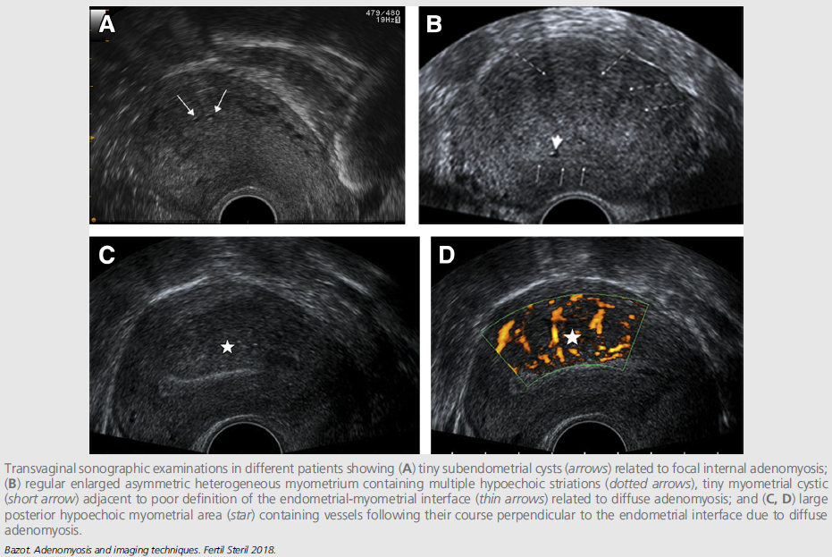

Slide 38
Ultrasonographic diagnostic criteria for adnomyosis. a Globulous aspect of the uterus. b Uterine asymmetry. Longitudinal section of a retroverted uterus, where the posterior uterine wall is clearly thicker than the anterior wall. c Heterogeneous myometrial texture. Transversal section of the uterus at the fundus level, where hypoechoic areas with radial pattern can be seen (arrows). d Linear striations. In this sagital section of an anteverted uterus thin hyperecogenic lines cross the myometrial thickness, visible from the endometrial-myometrial interphase. e Intramyometrial cysts. Transversal section of the uterus at the fundus level with sonoluscent images distributed in posterior wall of the myometrium. f and g, h Hyperechogenic nodules. Transversal (f) and coronal (g, h) sections of the uterus at the fundus level where hyperechogenic Intramyometrial areas can be observed (arrows). i Adenomyoma. Longitudinal section of a retroverted uterus with heterogeneous nodular mass lacking well-defined margins in the posterior wall

Slide 39
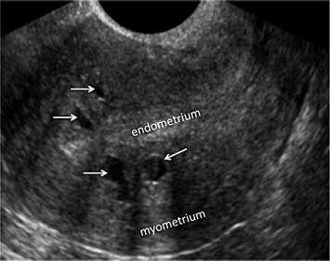
Transvaginal Sonography and Adenomyomas:
An adenomyoma appears on TVS as an ill-defined heterogeneous myometrial lesion containing hypoechoic spaces larger than 5 mm (39, 40).
With these criteria, TVS has a sensitivity of between 80%–87% and a specificity of between 94%–98% (39, 40)
Occasionally, TVS suggests a submucosal adenomyoma in the presence of an ill-defined endometrial mass containing cystic lesions protruding into the endometrial cavity.

Slide 40
Transvaginal Sonography and Internal Adenomyosis:
Non-cystic endometrial tissue gives rise to hyperechoic nodules or striations, of irregular or nodular aspect,
or poor definition of the endometrial-myometrial interface

Slide 41
Transvaginal Sonography and External Adenomyosis:
To the best of our knowledge, no publications describe the role of TVS in the detection of posterior external adenomyosis. Sonographers should bear in mind that this subtype is particularly difficult to detect and that diagnosis should always be considered, especially in the presence of posterior deep endometriosis (18).
In our experience, the outer posterior myometrial border appears heterogeneous on power Doppler analysis and can be seen to contain myometrial cysts and radial vessels (18).

Slide 42
Association with uterine leiomyomas
When an adenomyoma is present, appearances may closely mimic those of a uterine fibroid,.
The main differential diagnosis of adenomyosis is the association with uterine leiomyomas (with a coexistence of 40%) and represents one of the main limits of TVS.
Whatever its location, the differential diagnostic criteria with a leiomyoma are ill-defined margins and a cystic component (40).
The absence of vascularization, or peripheral vascularization, on color Doppler sonography reinforces the diagnosis.

Slide 43
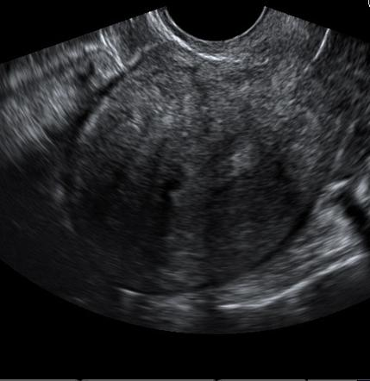
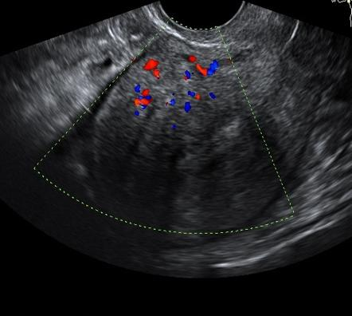

Slide 45
Hsg&CT
Hysterosalpingogram (HSG)
May show diverticula extending into the myometrium ³.
CT
CT is unable to diagnose adenomyosis but may suggest its presence when uterine enlargement is present. Distinguishing between adenomyosis and uterine fibroids on CT is difficult if not impossible, although the presence of calcifications strongly favours the latter

Slide 46
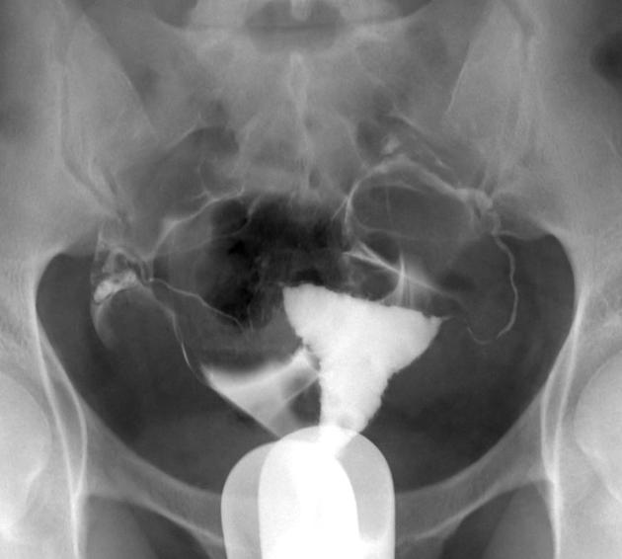
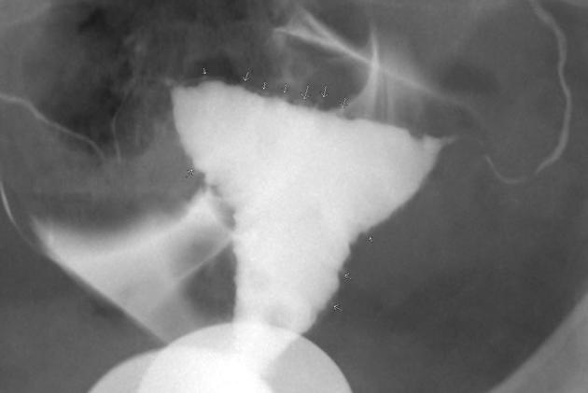

Slide 47
Adenomyotic hysteroscopic images become pathognomic after sub-endometrial exploration: (A) visible endometrial defects on uterine septum; (B) after incision different cystic structures become visible; (C) incision of lateral wall of T-uterus reveals the presence of adenomyotic cyst; (D) formation of cyst, still small opening is present; and (E) opening of this defect shows the inner sight of the cyst.

Slide 48
color Doppler sonography :
New US techniques are emerging and show promising results for the diagnosis of adenomyosis. Color or power Doppler US is useful to rule out the involvement of vascular structures (22).
In the presence of features mimicking leiomyomas, power Doppler US displaying vessels perpendicular to the endometrial interface, is suggestive of adenomyosis (Fig. 2C and D)

Slide 49
color Doppler sonography
Typically, ‘translesional flow’ is seen in adenomyosis, as opposed to the circular flow seen in fibroids

Slide 51
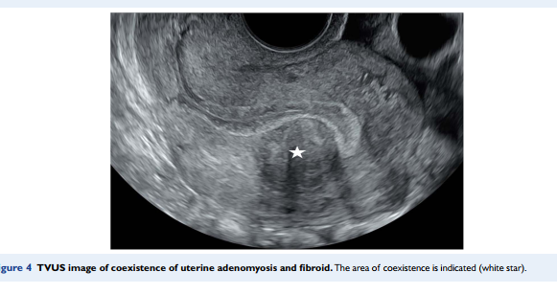

Slide 52
3 Dimentional sonography
Two previous studies suggest that reconstructed three dimensional TVS images provide :
superior visualization of the junctional zone (JZ) on the
coronal section,
facilitating analysis of the endomyometrial junction (28, 34).

Slide 53
Evaluation of the uterine cavity using 3D reconstrution mode in women diagnosed with adenomyosis. a Normal morphology of the uterine cavity, where JZ is thickenned and irregular, but the uterine cavity maintains its triangular shape. b Moderate alteration of the uterine cavity, with a convex shape in the upper cavity, and a narrowing of the lateral walls (arrows); myometrium is hypertrophic and irregular. c Severe modification of the uterine cavity, with funneling of the lateral walls (arrows), adopting a T-shaped morphology (arrows). Multiple hypoechogenic areas can be observed within the endometrium

Slide 54
Severe adenomyosis with multiple sonographic signs: multiplanar and 3D rendering of an anteverted uterus with multiple sonographic signs: myometrial cysts (white arrow), hyperechoic islands (yellowarrow), linear striations (green arrow), and irregularEMJ (black arrow). Sonographic Signs of Adenomyosis Are Prevalent in Women Undergoing Surgery for Endometriosis and May Suggest a Higher Risk of Infertility

Slide 58
Elastography
Elastography is another emerging US technique and uses slight external tissue compression to quantify the strain produced in the structures examined (36).
Two recent studies suggest significant differences in strain distribution between adenomyosis and leiomyomas (36, 37).

Slide 59
Elastography
strain elastography: differ in how the displacement is used; it may be imaged directly and converted to strain
shear wave elastography: used to detect the time of arrival of shear waves and hence their speed.

Slide 60
Elastography

Slide 61
Elastography

Slide 62
Elastography

Slide 63
Elastography
ultrasound shear wave elastography in adenomyosis diagnosis. It is a sufficiently accurate primary noninvasive method for the diagnosis of adenomyosis in clinically suspicious cases.
sensitivity:89.7
specificity :92.9%

Slide 64
Elastography
B-mode imaging based on subjective evaluation alone.
shear wave elastography, it seems possible to obtain statistically significant, objective information whilst reducing inter-operator variability.

Slide 65
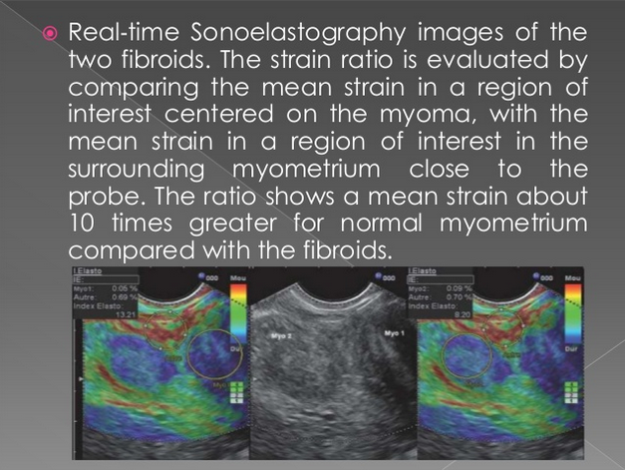

Slide 66
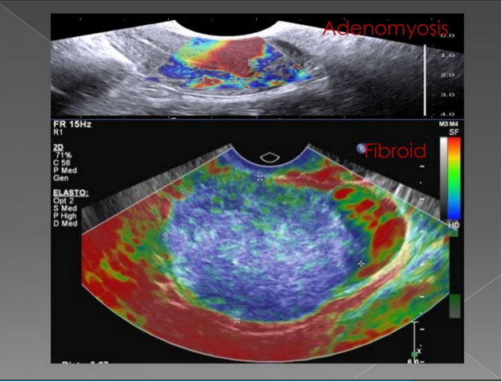
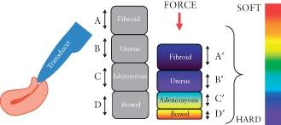

Slide 67
Elastography
TVUS SWE did not distinguish adenomyosis from leiomyoma
However, our pilot study demonstrated that myometrial SWVs were higher in uteriwith adenomyosis and leiomyomas than in uteri with myometrium with no abnor-malities suggesting a potential role for SWE in treatment response assessment

Slide 68
MRI
Pelvic MRI is the modality to diagnose and characterise adenomyosis,
T2 weighted images (sagittal and axial) are most useful.
MRI has a sensitivity of 78-88% and a specificity of 67-93% .
The most easily recognised feature is thickening of the junctional zone of the uterus to more than 12 mm, either diffusely or focally (normal junctional zone thickness is up to ~5 mm) .

Slide 69
MRI
T2
typically a region of adenomyosis appears as an ill-defined ovoid/diffuse region of thickening, often with small high T2 signal regions representing small regions of cystic change
the region may also have a striated appearance ⁵
T1
foci of high T1 signal are often seen, indicating menstrual haemorrhage into the ectopic endometrial tissues ⁷
T1 C+ (Gd)
contrast enhanced MR evaluation is usually not indicated for evaluation of adenomyosis, however, if performed, it shows enhancement of the ectopic endometrial glands

Slide 70
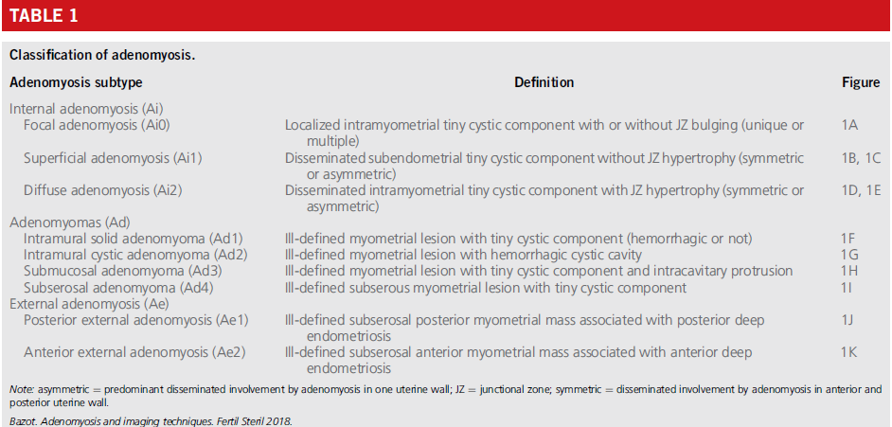

Slide 71
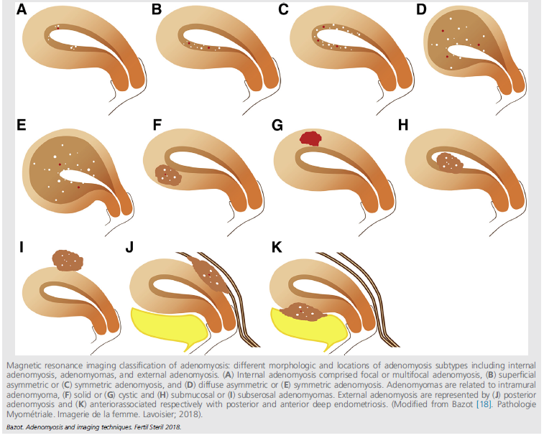

Slide 72
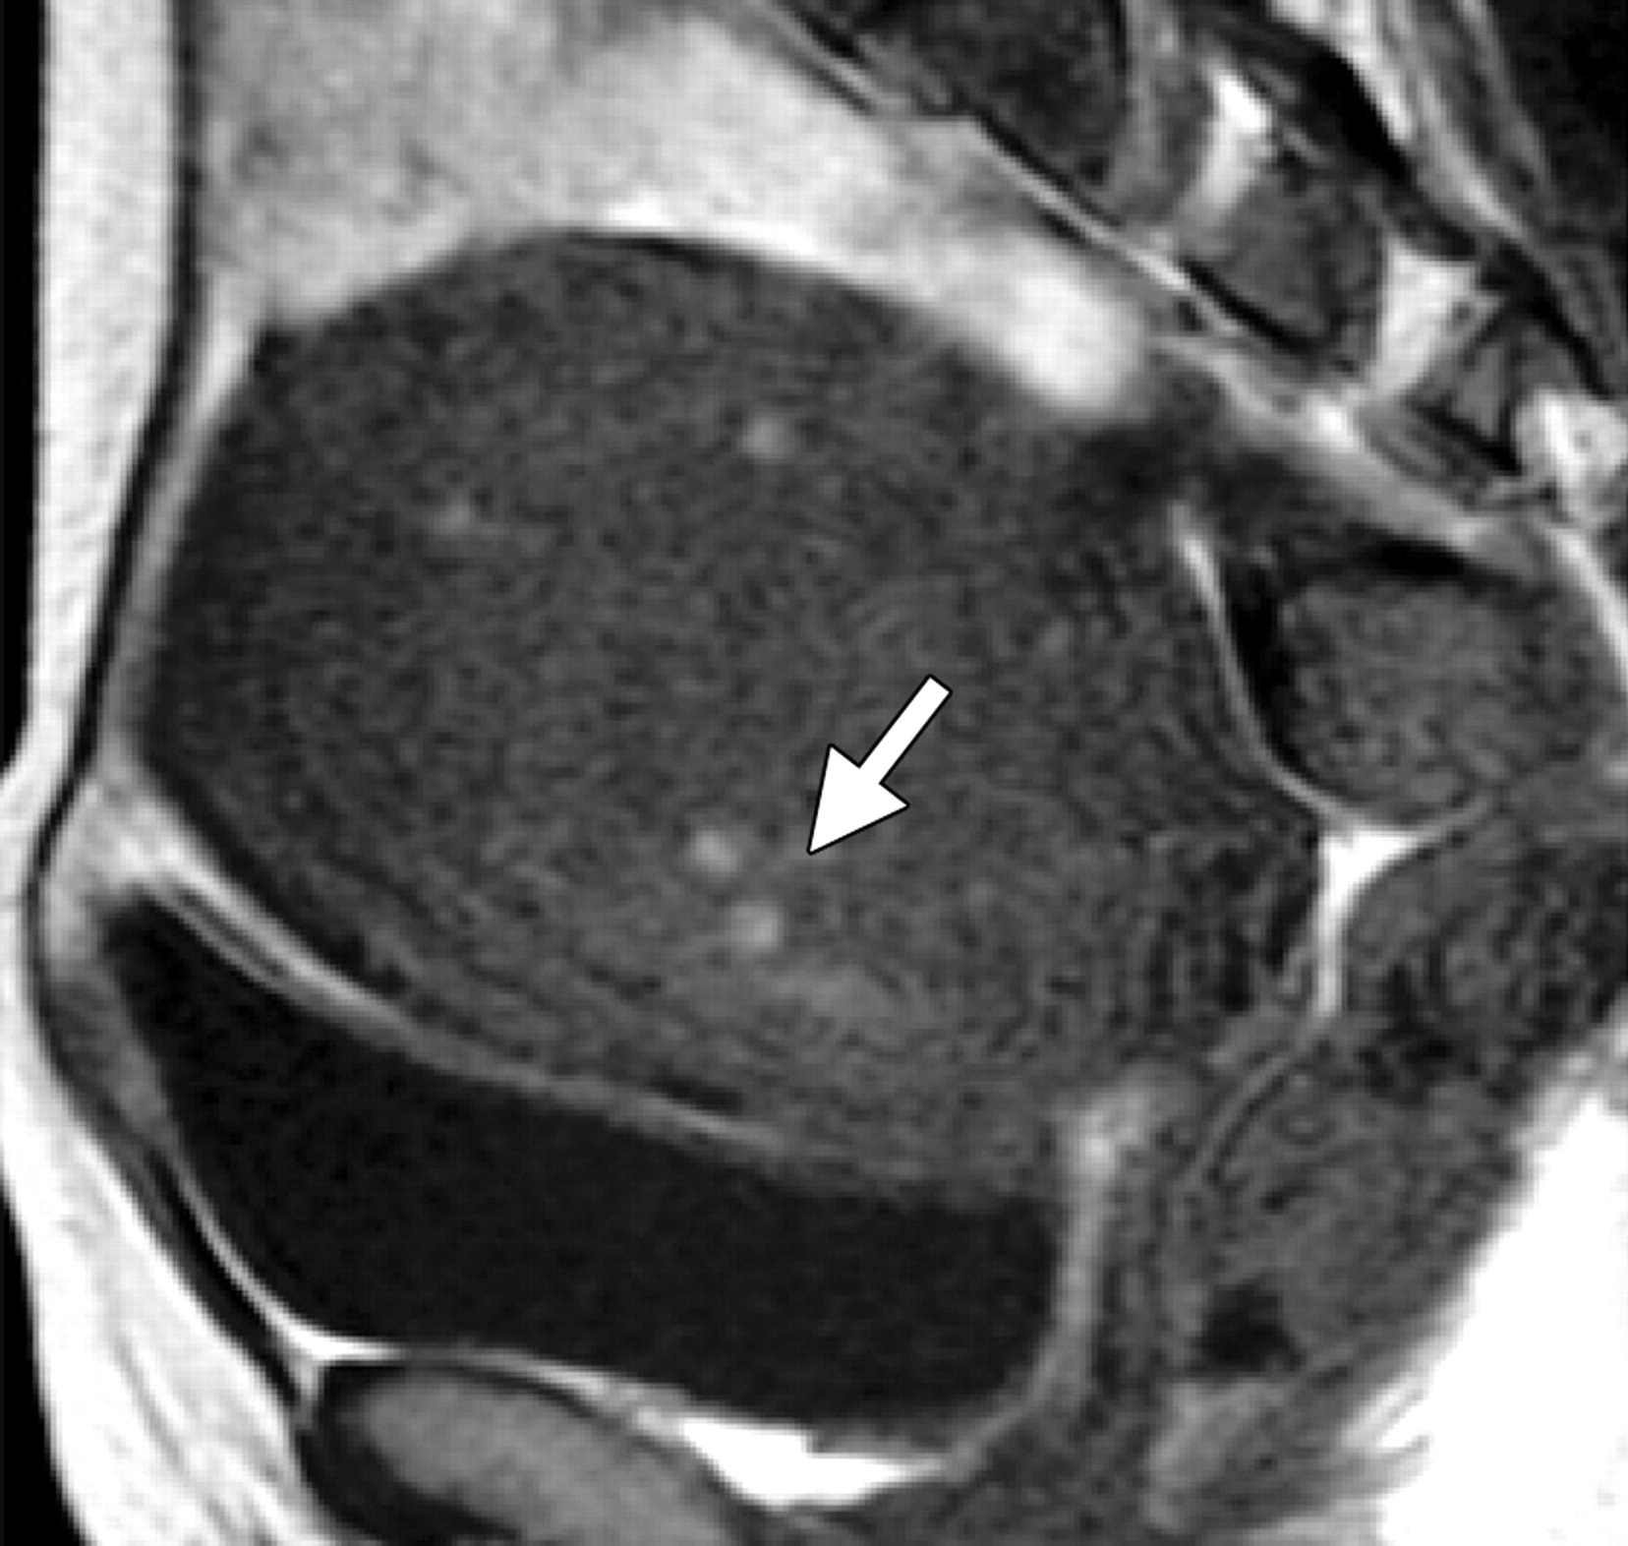
Adenomyosis in a 46-year-old woman. (a) Sagittal T2-weighted fast spin-echo MR image shows an enlarged uterus with an ill-defined low-signal-intensity lesion (arrow) in the posterior myometrium. The lesion contains multiple small high-signal-intensity areas, which represent ectopic endometrial tissue and small cysts. (b) Sagittal T1-weighted spin-echo MR image shows high-signal-intensity spots (arrow), which correspond to some of the small high-signal-intensity areas seen on the T2-weighted image. The high-signal-intensity spots represent hemorrhage within the ectopic endometrial tissue.

Slide 73
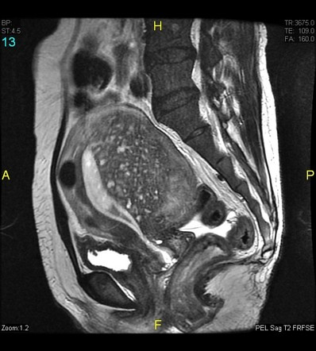
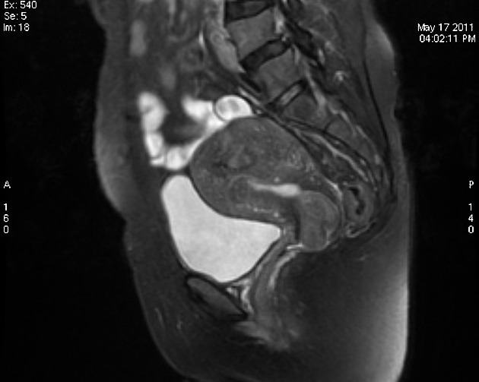

Slide 74
MRI
At diffusion-weighted imaging(DWI),
adenomyosis has low to intermediate signal intensity, a finding consistent with its benign, nonneoplastic nature However, there is no direct correlation between signal intensity at diffusion-weighted imaging and malignancy; most malignant tumors have very high signal intensity at diffusion-weighted imaging, a finding that reflects the long T2 relaxation time and restricted diffusion due to high cellularity.

Slide 75
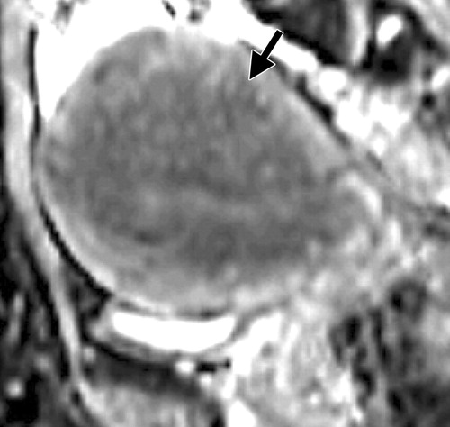
Adenomyosis in a 42-year-old woman. (a) Sagittal diffusion-weighted echo-planar MR image (b = 800 sec/mm²) shows an enlarged uterus with an ill-defined lesion of low to intermediate signal intensity (arrow) in the posterior myometrium. (b) Corresponding apparent diffusion coefficient (ADC) map shows no prominent decrease of ADC value in the area of adenomyosis (arrow).

Slide 76
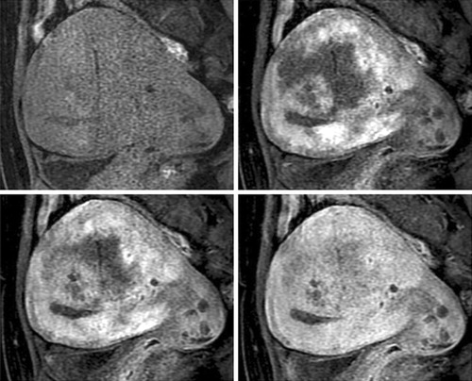
Adenomyosis in a 47-year-old woman. (a) Sagittal T2-weighted fast spin-echo MR image shows an enlarged uterus with an ill-defined low-signal-intensity lesion (arrow) in the posterior myometrium. The lesion contains multiple small high-signal-intensity areas. (b) Unenhanced (upper left), early arterial phase (upper right), late arterial phase (lower left), and venous phase (lower right) images, obtained with a dynamic gadolinium-enhanced three-dimensional fast spoiled gradient-echo sequence with fat suppression, show heterogeneous and gradual enhancement of the lesion.

Slide 77
Atypical MR Imaging Manifestations of Adenomyosis
Various physiologic or pathologic states may affect the MR imaging appearance of adenomyosis: amount of functional endometrial tissue, phase of the menstrual cycle, endogenous hormonal abnormality, and exogenous hormonal stimulation .
Secretory transformation of adenomyotic endometrium including stromal decidualization may cause a heterogeneous increase in signal intensity on T2-weighted images. This phenomenon may be encountered during gestation and exogenous progestational therapy or even in patients without specific hormonal stimulation
Congestion or edematous change may also increase the signal intensity of adenomyosis diffusely or focally on T2-weighted images .
In such conditions, MR imaging manifestations may fluctuate, and follow-up MR imaging may be helpful for diagnosis. Gonadotropin-releasing hormone analog is used in the treatment of adenomyosis. After hormonal therapy or menopause, an area of adenomyosis may shrink with decreased signal intensity on T2-weighted images..

Slide 78
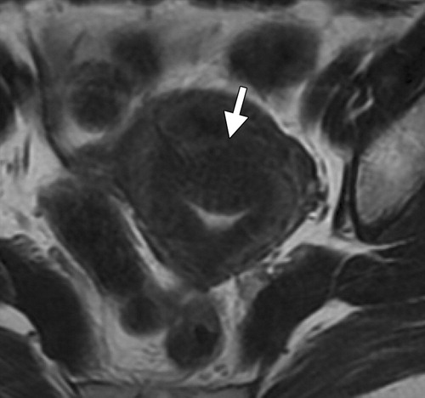
Adenomyosis in a 50-year-old woman before and after hormonal therapy with gonadotropin-releasing hormone analog. (a) Axial T2-weighted fast spin-echo MR image shows adenomyosis as an ill-defined heterogeneous low-signal-intensity lesion with linear or reticular high-signal-intensity areas in the anterior myometrium (arrow). (b) Axial T2-weighted fast spin-echo MR image obtained after hormonal therapy shows decreased volume and signal intensity of the area of adenomyosis (arrow).

Slide 79
Pitfalls in Diagnosis of Adenomyosis
Physiologic Changes in the Uterine Body during the Menstrual Cycle
The uterine body may show physiologic changes during the menstrual cycle. The low-signal-intensity junctional zone and adenomyosis are well visualized due to increased signal intensity of the myometrium in the secretory phase (luteal phase). Decreased signal intensity of the myometrium in the menstrual–early proliferative phase (follicular phase) may cause widening of the junctional zone, which mimics diffuse adenomyosis
Therefore, MR imaging for the evaluation of a uterine myometrial lesion should be performed in the late proliferative–secretory phase

Slide 80
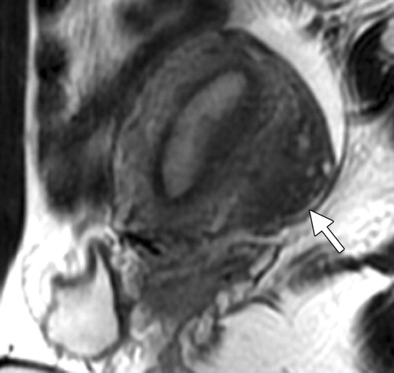
Subserosal adenomyosis-like lesion (invasive solid endometriosis) in a 33-year-old woman during different phases of the menstrual cycle. (a) Sagittal T2-weighted fast spin-echo MR image obtained in the early proliferative phase shows decreased signal intensity of the myometrium. The boundary between the myometrium and a subserosal adenomyosis-like lesion (arrow) is obscure. (b) Sagittal T2-weighted fast spin-echo MR image obtained in the late secretory phase shows increased signal intensity of the myometrium. The low-signal-intensity junctional zone and the subserosal adenomyosis-like lesion (arrow) are clearly visualized.

Slide 81
Atypical Morphologic Appearances of Adenomyosis
Adenomyoma
Adenomyoma is characterized as a solid, masslike, localized form of adenomyosis. Adenomyoma may appear as an intracavitary or subserosal polypoid mass or as an intramyometrial mass. Subserosal polypoid adenomyoma may mimic subserosal leiomyoma or leiomyosarcoma.Adenomyomatous polyp, which is often associated with tamoxifen therapy, is an endometrial polyp with significant amounts of smooth muscle and is histologically identical to polypoid adenomyoma in the uterine cavity
Adenomyotic Cyst
Adenomyotic cyst (cystic adenomyosis) is a rare variation of adenomyosis that appears as an endometrioma-like intramyometrial hemorrhagic cystic mass surrounded by adenomyotic tissue .Adenomyotic cyst may appear as an intracavitary or subserosal polypoid cystic mass or as an intramyometrial mass
Pseudowidening of the Endometrium
On T2-weighted images, the endometrial junction may be obscured due to high-signal-intensity linear striations radiating from the endometrium to the area of adenomyosis. Occasionally, pseudowidening of the endometrium may occur as a result of the blending of striations .This phenomenon may fluctuate according to the hormonal state of the patient.

Slide 82
Subserosal polypoid adenomyoma in a 39-year-old woman. Coronal T2-weighted fast spin-echo MR image shows a huge, exophytic, subserosal uterine mass (arrow) with heterogeneous signal inten-sity, an appearance that mimics uterine sarcoma.

Slide 83
Adenomyomatous polyp (polypoid adenomyoma) in a 64-year-old woman treated with tamoxifen. Axial gadolinium-enhanced T1-weighted spin-echo MR image shows intense enhancement of the fibrous-muscular components and no enhancement of the cystic dilated glands in the mass (arrow).

Slide 84
Adenomyotic cyst in a 39-year-old woman. Sagittal T2-weighted fast spin-echo MR image shows an intramyometrial hemorrhagic cyst surrounded by a low-signal-intensity area of adenomyosis (arrow). M = myoma uteri

Slide 85
Adenomyosis with coexisting endometrial cancer in a 53-year-old woman. Sagittal T2-weighted fast spin-echo MR image shows a uterus with adenomyosis and endometrial thickening. Striated high-signal-intensity areas cause pseudowidening of the endometrium (arrow), an appearance that simulates myometrial invasion by endometrial carcinoma

